Slide 1

Being Effective at Technical Communication
Technology Not Required
aka You Suck At Communicating (Thanks Ariel)
Joe Houghes
Solutions Architect
FullStackGeek, Lazy Admin

Slide 2



About Me
Co-leader - Austin VMUG & PowerShell User Group
Green hat, big grin and the loud "Howdy Y'all.“
Push yourself outside of your comfort zone
Learn more about any topic of interest
Stop letting fear keep you from sharing with others
Share your knowledge (Perspective is important)
Teach whatever you can (Be The Master)

Slide 3
What are we here to talk about? (My Own Failings)
Definitions of communication/effective communications
  Merriam-Webster: “the act or process of using words, sounds, signs, or behaviors to express or exchange information or to express your ideas, thoughts, feelings, etc., to someone else.”
  Google: “the imparting or exchanging of information by speaking, writing, or using some other medium” and “means of sending or receiving information, such as telephone lines/computers.”
  Effective communications (by Joe): Ensuring that you & your audience are both understood, and feel that it was a successful exchange
What's the real point?
  Getting the message across
  Getting YOUR message across

Slide 4
Why should you Care?
Critical to your relationships in life, not just business
Consider how you communicate with:
  Spouse/partner/significant other
  Children
  Parents / Close Family
  Co-workers – especially ones you may not be fond of
  Man on the Street
Communications enable connections – especially social ones
Don’t be Asshole Joe

Slide 5
What are you bring to the conversation unconsciously?
Perceptions/Notions
What Prevents Effective Communication
  Your emotions
  Others’ emotions
  Stress and other external influences
  Lack of focus
Personality as Code
  Change your defaults

Slide 6
Know Your Audience
Look for background connections
Areas of common understanding
Smart person vs wise person
Don’t repeat mistakes without change
Peers are effective tools, may need their support

Slide 7
Learn You Some Business
Speak to your Audience in THEIR terms
Know what is important to your business
Is IT really your business? (It's your job, but it's probably not the business)
Technical Fellow of Cafeterias
PRO TIP:
Your job belongs to your employer
Your career belongs to YOU

Slide 8
Actively Listen
Listen as much as you speak, if not more
Necessary for 2-way communication
2 Parts:
  Sending the message
  Receiving (and interpreting) the message
Listen, Repeat, Get & Give Feedback
Make sure you are both understood
  Ask open-ended questions to promote discussion & comprehension

Slide 9
Non-verbal Communications
Body language & engagement
  Barrier for many people who are not comfortable with interpersonal communications
  Key indicator of people being non-receptive, disinterested or lacking confidence
  Eye contact, eye contact, eye contact!
  Be relaxed, keep an open stance
Distractions
  Laptops, phones, e-mail, chat – ask for people’s attention
  Some distractions are external to your exchange
  Not all distractions can be avoided or controlled

Slide 10
Delivery method
Are you using the right medium?
  Are you explaining your concept in simple or easy to follow terms? (Avoid acronym soup)
  Are people in your audience visual or auditory learners?
  Even for auditory learners, images can make abstract concepts easier to follow
Do this with your visual presentation:
  Walk through your concept slowly – don’t start with the eye charts
  Periodically ensure that people are following with your walk through
  PRO TIP: Be mindful of color blindness with your slides or images (red/grn, bl/grn, bl/brn)

Slide 11
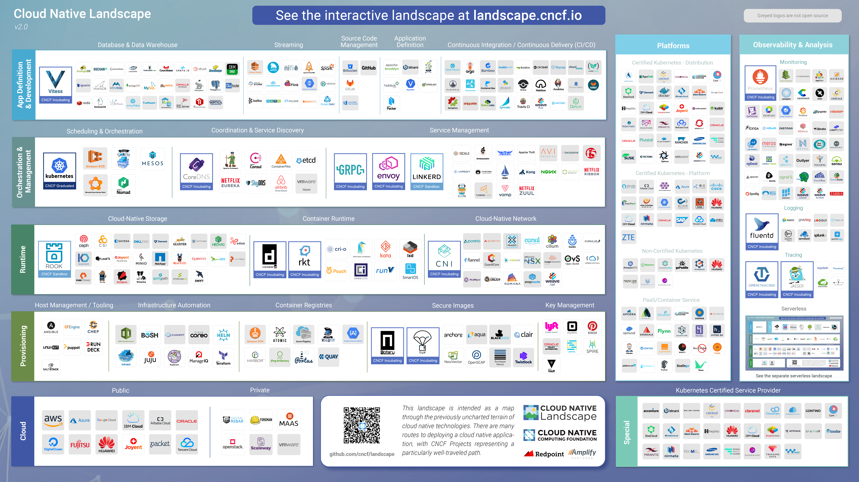
Visual Medium

Slide 12
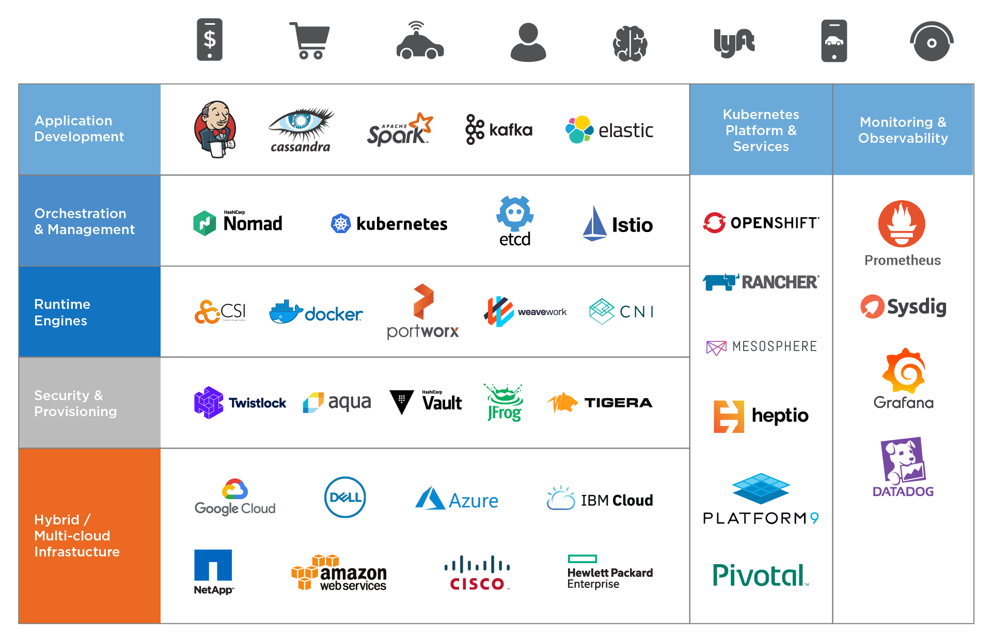
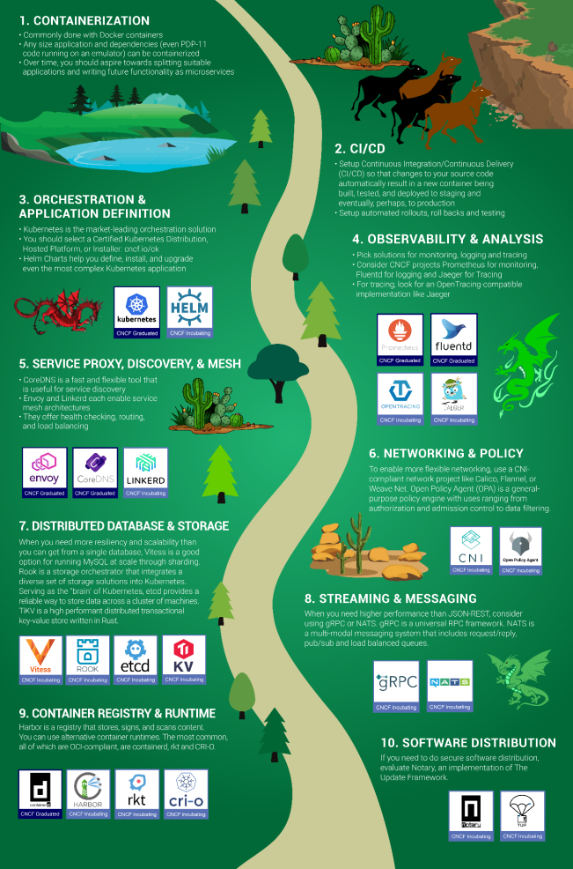
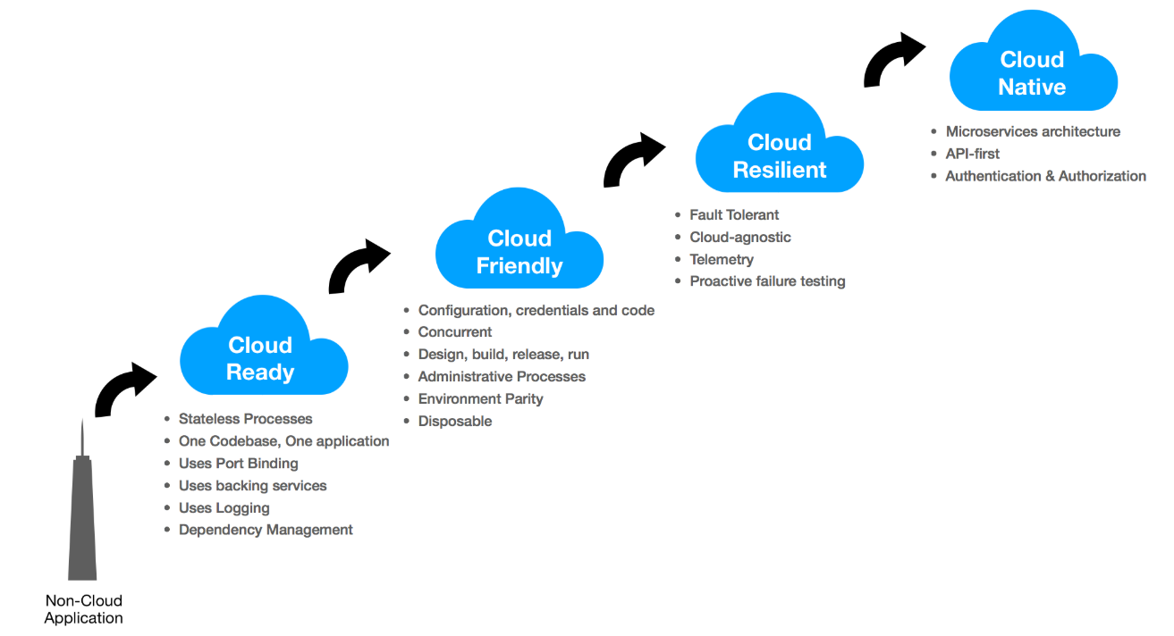
Visual Medium

Slide 13
Personality Types
What are your motivations?
What are your goals?
What drives your interest?
Do you know what these answers are for people in your audience?
Emotions come into play, again
True Colors

Slide 14
Back It Up - My story from the near beginning
Boss was Yellow (fun focused), CIO was Gold (task focused)
How I discovered I was a Green (PURE technologist)
How that was publicly presented to me
The challenge after the training - Cut off from technology
How many seats on a boat?
Assigned Homework? It's a book report?!?!?!
Team Miracle

Slide 15
Tell a Story
Bring the audience with you
Make a personal connection
Draw in your audience (or pull them back in)

Slide 16
Respect & Empathy
Friendliness - Just Be Kind
  We're all in this together
My #1 Rule - Apologies for being crude
Don't hold grudges

Slide 17
Open-Mindedness & Awareness
Be willing to change
Break out of your box
Encourage others to grow and change
The party is better when we're all invited

Slide 18
Confidence & Persuasiveness
Hearts & Minds
Not selling or tricking anyone
Let others reach their own conclusions and compare
Be Patient

Slide 19
Sound Bytes
Crucial Conversations - It's Not About Communication, it's About Results
Showing Our True Colors - Understand Your & Their Values, Needs, Strengths, Joys
Personality Lingo - Identifying your Personality; Breaking Out of a Box
Verbal Judo - The Gentle Art of Persuasion; What Not to Say
High Five! - None of Us Is As Smart As All Of Us
Soft Skills - Software developer's life manual

Slide 20
Do this for yourself
You will have greater personal success if you do this
Better relationships with family & friends
Better business relationships & status
Fewer instances of misunderstanding makes all things of 1+ persons easier
Go fast versus go far

Slide 21
Book Recommendations
*Crucial Conversations (It's Not About Communication, I's About Results)
*Showing Our True Colors (Understand Your & Their Values, Needs, Strengths, Joys)
*Personality Lingo (Identifying your Personality - Breaking Out of a Box)
*Verbal Judo (The Gentle Art of Persuasion - What Not to Say)
*High Five! (None of Us Is As Smart As All Of Us)
*Soft Skills (Software developer's life manual)
How to Win Friends & Influence People
Presence: Bringing Your Boldest Self to Your Biggest Challenges
The Naked Presenter: Delivering Powerful Presentations With or Without Slides
The 17 Essential Qualities of a Team Player: Becoming the Kind of Person Every Team Wants
Great Work, Great Career
The Back of the Napkin (Expanded Edition): Solving Problems & Selling Ideas with Pictures
Switch: How to Change Things When Change Is Hard
Reclaiming Conversation: The Power of Talk in a Digital Age
The Secret Lives of Introverts: Inside Our Hidden World
Quiet: The Power of Introverts in a World That Can't Stop Talking
Never Split the Difference: Negotiating As If Your Life Depended On It
The No Asshole Rule: Building a Civilized Workplace and Surviving One That Isn't
Stress Less, Accomplish More: Meditation for Extraordinary Performance
Math with Bad Drawings: Illuminating the Ideas That Shape Our Reality
Ego Is the Enemy
Talk Like TED: The 9 Public-Speaking Secrets of the World's Top Minds
TED Talks: The Official TED Guide to Public Speaking
Management Focused (team leadership as well):
An Elegant Puzzle: Systems of Engineering Management
The Manager's Path: A Guide for Tech Leaders Navigating Growth and Change
The Ideal Team Player: How to Recognize and Cultivate The Three Essential Virtues
Unlearn: Let Go of Past Success to Achieve Extraordinary Results
Team Players and Teamwork: New Strategies for Developing Successful Collaboration
The Five Dysfunctions of a Team: A Leadership Fable

Slide 22

Thank You for Listening!

